Slide 1

Chen Song
- PhD in International Political Economy
- Master in Data Science
(412) 932–3877
chensong5225@gmail.com
http://www.linkedin.com/in/chensong5225

Slide 2
A Search Engine for Healthy Recipes
Chen Song

Slide 3
Introduction: why we need a search engine of healthy recipes?
Great demand of living a healthier lifestyle:
The US accounts 5% of the world population, but 13% of global overweight and obese people.
The American diet is said to be increasingly energy-rich but nutrient-poor.
Cooking from fresh ingredients at home is a much healthier way of eating.
Lack of demanded product in the market:
Recipe recommendation websites like allrecipes.com and epicurious.com can solve the problem of what to cook, but they cannot tell us how to cook it in a healthier way.

Slide 4
Introduction: Target of the Project
A search engine which can recommend recipes based on:
Search Queries
Healthy index
User’s taste

Slide 5
Overview: How to implement the search engine
Data collection
Data analysis
Implement a search engine based on keyword searching
Embed the result of data analysis into the search engine
Notes:
After a glance of our dataset, we notice that it is really large. So it is important to find a better way for selecting important features and doing the dimensionality reduction. Therefore we found some works related to dimensionality reduction. This article is from Laurens, Eric and Jaap compared various techniques of dimensionality reduction like PCA, Isomap, LLE and so on with advantages and disadvantages. Each dataset has its suitable techniques for dimensionality reduction. So based on the comparison in the article and analysis of our data, we decided to use PCA to maximize the maintenance of original data, and LDA to easily classify our data. And to see which one is better.
Our safe driver's prediction needs a classification result with two classes. Therefore we also found some works related to classification techniques and how they evaluate the final results to generate a better prediction. In this article (Supervised machine learning: A review of classification techniques), we learned that it is more sufficient to use various techniques like speed, tolerance to noise and so on to do the evaluation rather than only use accuracy. So we decided to add precision and recall and also ROC curve to evaluate our models carefully.

Slide 6
Part I: Data Collection
Desired dataset:
The texts: normal recipe contents including title, ingredients, cooking instructions, etc.
The numbers: nutrition facts
An index of ”healthy”: could be label or score
User information: ratings, reviews, etc.
There is no existed dataset fulfils all the needs. Luckily, epicurious.com has all the information. Need to write my own web crawler.

Slide 7
Part I: Data Collection
In week 1, I learned to write the web crawler I need. See what I got:

Slide 8
Comments & Suggestions, Please!

Slide 9
Part II: Data Analysis

Slide 10
Part III: Search Engine

Slide 11
Part IV: Embedding

Slide 12
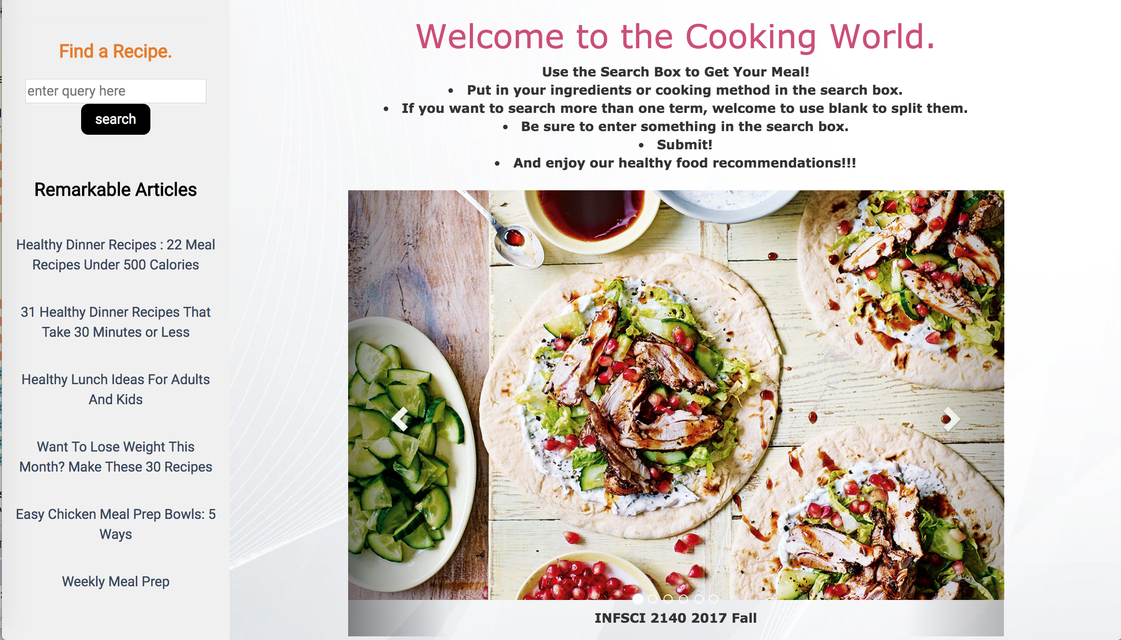
Screen Shot: Main page

Slide 13
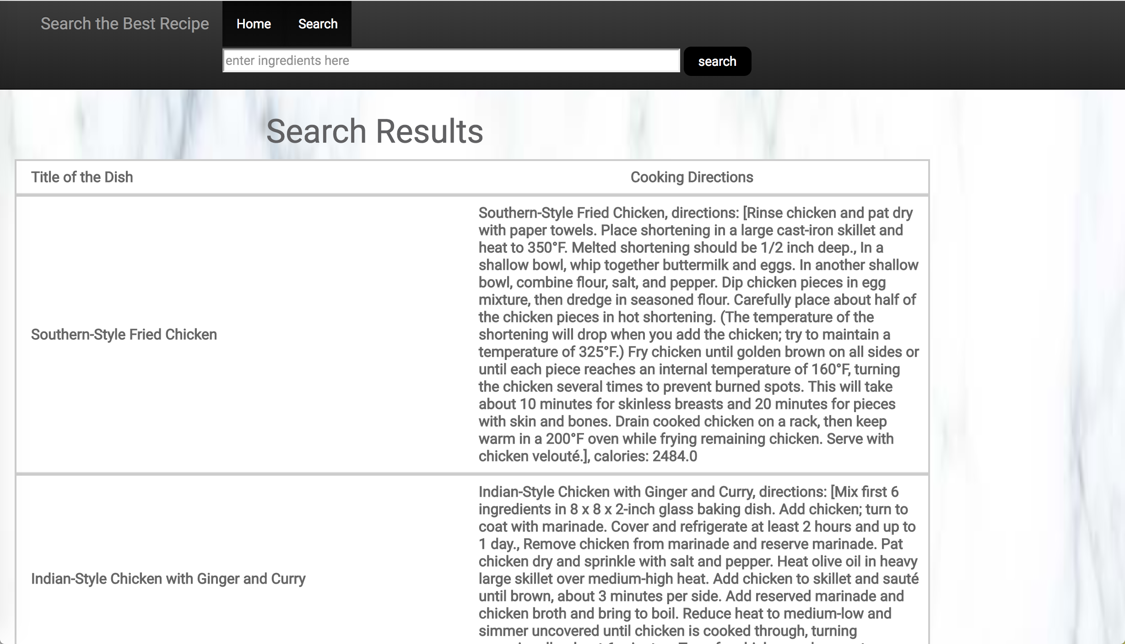
Screen Shot: Search result page

Slide 14
Screen Shot: Recipe detail page

Slide 15
For Demo, please click this link: http://heroku...

Slide 16

Thanks!

